Slide 1
ElectViz: Election Data Visualization for Media
Team-D
Neelapu Herambudu

Slide 2
INTRODUCTION
Elections generate large volumes of complex data that can be difficult to interpret in raw form. Effective data visualization helps transform this data into clear insights that support transparency, media reporting, and public understanding.
ElectViz – Election Data-Based Dashboard is a data visualization project that analyzes historical U.S. House election data to present voting trends, party performance, and state-wise outcomes through interactive dashboards. By enabling filters for year, state, party, and election type, the project supports intuitive exploration and data-driven storytelling.
Overall, ElectViz demonstrates how visual analytics can simplify election data and make democratic processes more accessible and understandable for media and the public.

Slide 3
Workflow & system design
Workflow
Election data is collected from public sources in CSV/Excel format.
The data is cleaned, filtered, and transformed to handle missing values and create required metrics.
Processed data is modeled for analysis using year, state, party, and election type.
Interactive dashboards are created using suitable charts and filters.
Insights are generated to support media-friendly election storytelling.
System Design
The system follows a simple layered design:
Data Layer: Stores raw and cleaned election data
Processing Layer: Performs calculations and aggregations
Visualization Layer: Displays insights through interactive dashboards

Slide 4
Future enhance
Integrate real-time election data to provide live updates during ongoing elections.
Apply predictive analytics and machine learning to forecast election outcomes and voter trends.
Include demographic data (age, gender, urban–rural) for deeper voter behavior analysis.
Add AI-generated insights and automated headlines to support media reporting.
Improve interactivity and drill-down capabilities for constituency-level analysis.

Slide 5




outputs

Slide 6

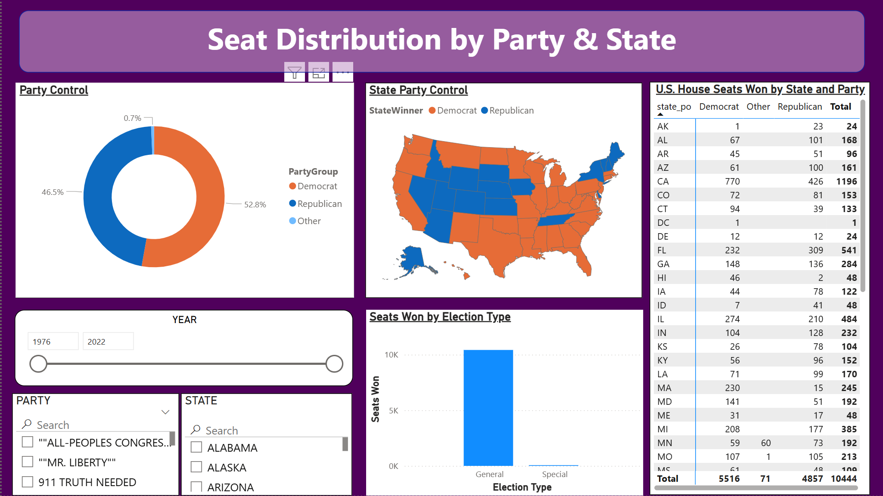



Slide 7
conclusion
The ElectViz – Election Data Visualization for Media project successfully transforms complex election data into clear, interactive, and media-friendly dashboards. By analyzing historical U.S. House election data, the system highlights voting trends, party performance, state-wise outcomes, and electoral competitiveness. The project demonstrates how data visualization and storytelling can improve transparency, support data-driven journalism, and enhance public understanding of democratic processes.

Slide 8
Thank you

